Slide 1
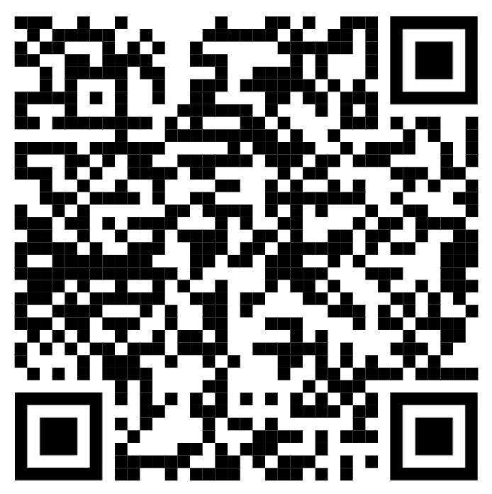
Creating an ESP Service List from a Subject-Specific Corpus
Andrew Blaker
Kwansei Gakuin University
a.blaker@kwansei.ac.jp

Slide 2
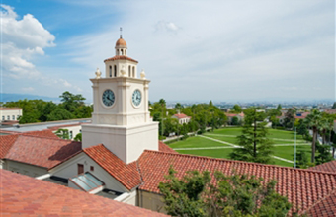
About Me
English Instructor
Newly Formed School of Architecture
Kwansei Gakuin University
Sanda, Hyogo, Japan

Slide 3
Architecture English Courses
Two Years of English
4 semesters
What English to Japanese Architects need?
Three Courses:
Reading
Writing
Communication

Slide 4
Today’s Contents
01
02
03
04
Corpora
NGSL
The importance of using frequency-based vocabulary
The example of the New General Service List
Coverage
Creating
The Process of creating your own lists
Measuring the effectiveness of vocabulary lists

Slide 5
Today’s Contents
00
Practical
The most important thing I want to show you today is how fast and easy it is to create a list using free and easy to use resources

Slide 6
Corpora
Using real language to determine what to teach language students.
“A large, principled collection of natural text”
-this morning’s plenary

Slide 7
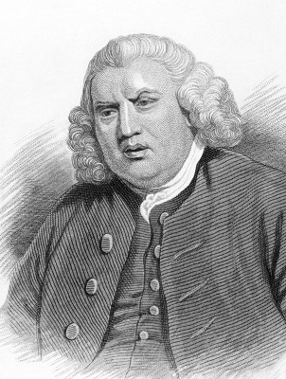
Corpus Linguistics
In the 18th Century, Samuel Johnson used his knowledge of the language to write the first English dictionary.
This was created by his knowledge based on all of the books he and his 6 assistants had read.
This was his corpus. His body of knowledge.

Slide 8
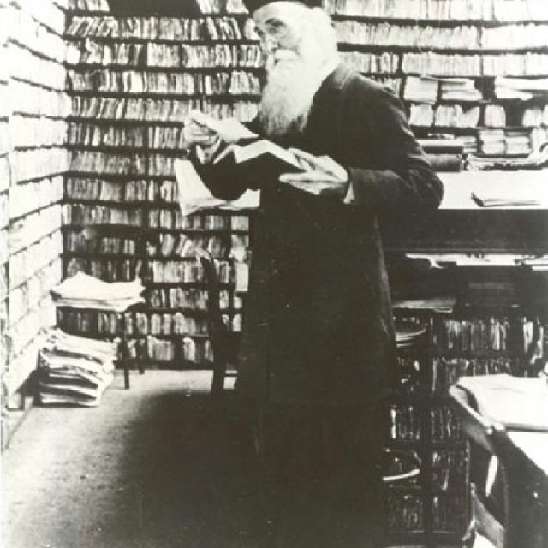
Corpus Linguistics
In the 19th Century, James Murray used a large out-sourced team of writers to compile the first Oxford English Dictionary.
They used all the books in all the libraries available to them.
The increase of the size of the corpus resulted in an increased quality of their output.
The cost was huge amounts of time.

Slide 9
General Service List
In 1953, Michael West used a corpus of 600,000 words to create a list of the 2,000 most used words in English.
This was and early corpus-based frequency list called the General Service List (GSL)
Date
1953
Corpus Size
600,000 words
List Items
2,000 headwords

Slide 10
Corpus Linguistics
Our ideas about language are not always true.
Corpus linguistics uses large-scale collections of language in use. Computing power gave rise to the ability of us to compile and query massive amounts of language. The key is language in use.
Using a corpus provides evidence of usage patterns, grammar, and vocabulary from real language in use.
BNC
British National Corpus - Over 100 million words.
COCA
Corpus of Contemporary American English - 1.1 Billion Words
OEC
Oxford English Corpus - 2 Billion Words

Slide 11
NGSL
The New General Service List
Using computer processing to determine frequency from large corpora.

Slide 12
Frequency Based Vocabulary
The New General Service List (NGSL) was developed in 2013 (Browne, 2013a). It used a corpus of 273 million words to determine the most commonly used words in current English.
It was determined that its 2801 words were enough to understand over around 92% of most standard English texts.
Corpus Size
273,000,000 words
Number of Items
2801 words
Coverage
Over 90% of standard English

Slide 13
NGSL - Coverage
After testing at the beginning of the first year, my students already have a large receptive vocabulary of between 5-10,000 headwords.
We use the NGSL over the 4 semesters, asking students to review the words for homework each week.
These words are included in output activities, often focussed on disabusing students of notions about certain vocabulary.
We make sure the students can produce the words
Output Focus
Number of Items
~50 words per week is expected
Highlighting
We try to make sure the materials given to students in all 3 subjects highlight recent items.

Slide 14
Examining Writing/Corpora
I used a program called ‘AntWordProfiler’
It is created by Laurence Anthony, and is available at
www.laurenceanthony.net
Let’s take a look now.
Corpus
Select the corpus
Reference Lists
Select the word lists to compare it to.
Results
It shows you the how the words of the corpus are broken down.

Slide 15
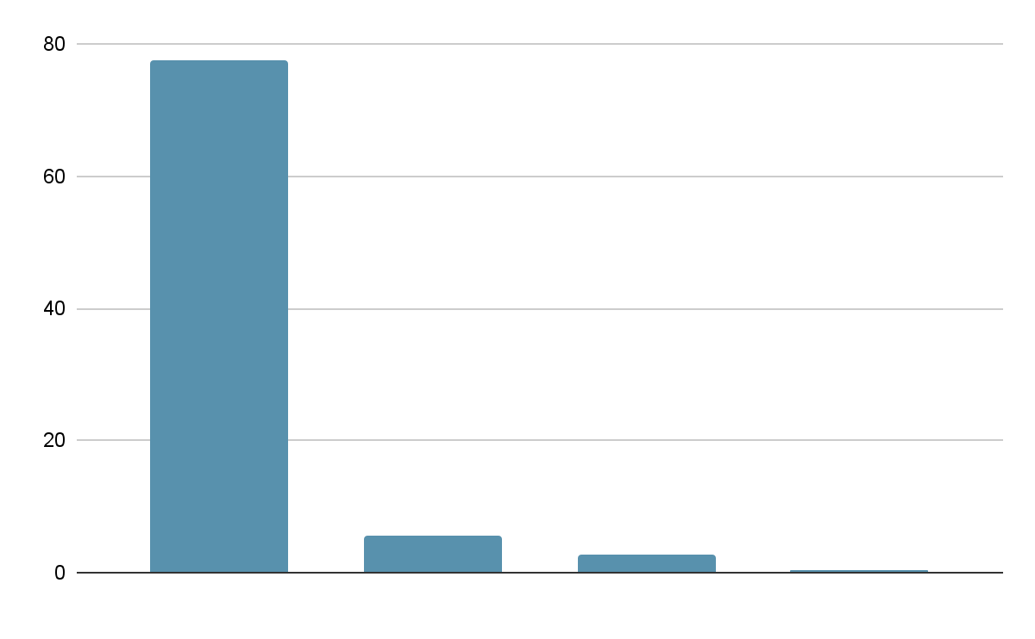
NGSL/NAWL Coverage
Harry Potter
All NGSL words make up 83% of the words used in the Harry Potter book.
This means the NGSL Coverage of this writing is 83%.
AWL
1000
2000
3000
77.6%
5.4%
2.8%
0.4%

Slide 16
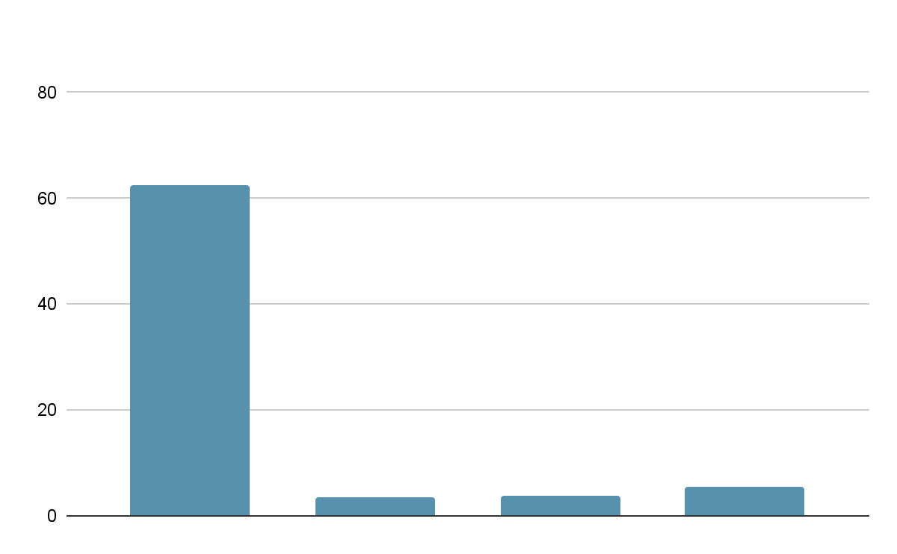
NGSL/NAWL Coverage
Specialist Topic - Architecture
The NGSL coverage has fallen to 71.2%.
Including the AWL, it is 73.6%.
AWL
60.9%
7.1%
3.7%
2.4%
1000
2000
3000

Slide 17
Specialist Vocabulary Lists
There are many vocabulary lists to aid coverage in specialist subjects.
Each aids students maintain coverage of specialist reading materials.
Business
Medical
BWL2; Hsu, 2011 a
MAWL; Wang, Liang, & Ge, 2008
Engineering
Science
BEL; Ward, 2009 a
SWL; Coxhead & Hirsh, 2007

Slide 18
Specialist Vocabulary Lists
There is a need for any subject that is being studied by ESL/EFL students to have such a list.
There should be a simple way any teacher in these fields should be able to create their own frequency based list.
I will describe the process I have gone through for generating my own list.
Corpus Creation
Assembling your own subject corpus
Processing
Determining unique words
Implementation
Putting it into use in the classroom

Slide 19
Corpus Creation - Architecture
First, we need to decide what ‘Architecture English’ means.
Distinct from everyday English.
Accessible.
Entry level for native speaker.
I chose university-level first year Architecture textbooks
Selection
Assemble the texts
Extract Text
Strip the documents to text-only versions
Combine
Put all text into one document.
This is our corpus of architecture English.

Slide 20
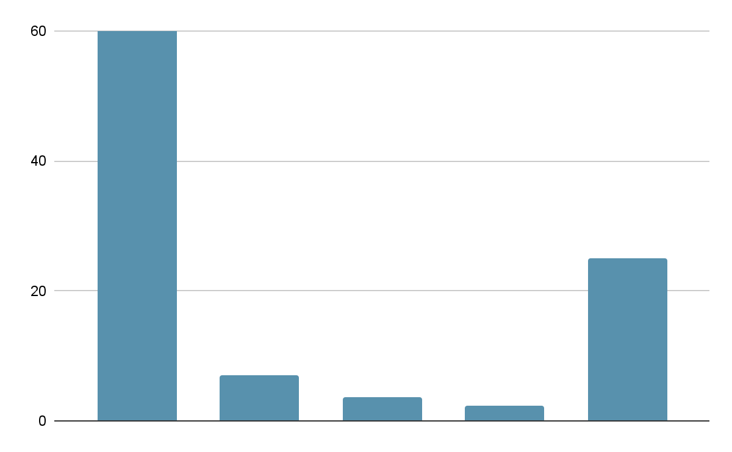
Initial Coverage
As seen before, this is the coverage of NGSL & AWL lists.
The analysis also shows us the words that are not included in the current lists - over one quarter of the words!
This is the gap we want to fill
AWL
NIL
60.9%
7.1%
3.7%
2.4%
26.4%
1000
2000
3000

Slide 21
Fine-Tuning the List
I have depended heavily on the research of Averil Coxhead for guidance on how to refine the list to determine the best word to choose for my final vocabulary list
What’s Missing?
Make a list of words not currently covered
Remove Names
Proper nouns are not considered
Remove Foreign
We are looking at English only
Low Frequency
Remove words that don’t occur often
Decide Size
How big of a vocabulary list do we want?
What is our coverage goal?

Slide 22
What’s Missing
Of my modestly sized corpus of 677,000 words, 15,491 are not covered by NGSL or AWL.
I manually reviewed the list of missing words, identifying names of people and places, creating a list to add to my processing.
What’s Missing?
Make a list of words not currently covered
Remove Names
Proper nouns are not considered

Slide 23
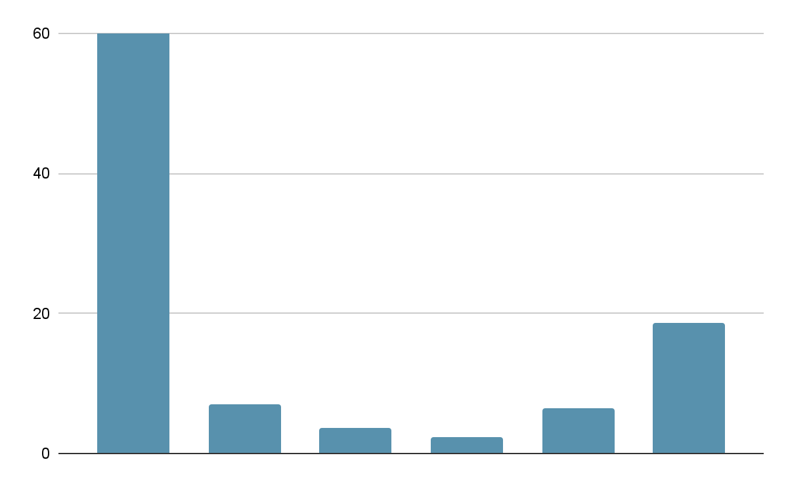
Initial Coverage
As seen before, this is the coverage of NGSL & AWL lists.
If we remove names from the list, we can reduce the number of total tokens
AWL
Names
NIL
60.9%
7.1%
3.7%
2.4%
6.4%
18.6%
1000
2000
3000

Slide 24
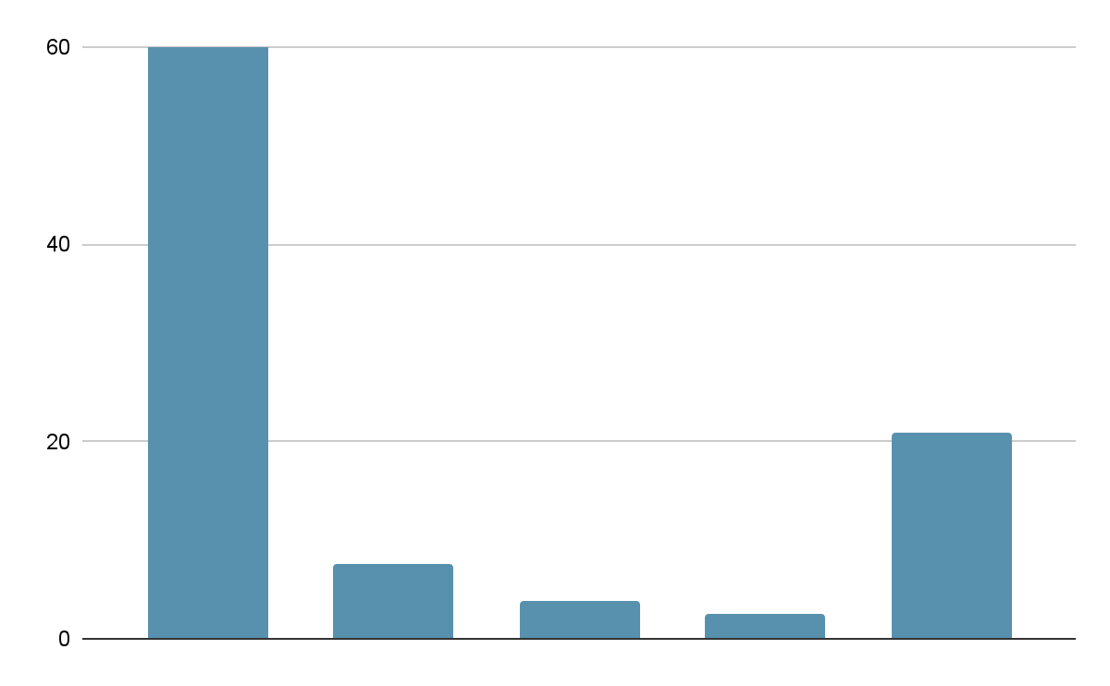
Initial Coverage - Reduced Tokens
As seen before, this is the coverage of NGSL & AWL lists.
Next, I removed words that were not English in origin.
This proved to be only 2000 tokens and had minimal effect on the total number of tokens in the corpus.
AWL
NIL
64.8%
7.6%
3.9%
2.6%
20.9%
1000
2000
3000

Slide 25
Fine-Tuning the List - Low Frequency
There are 14,078 items remaining in the corpus that are not covered by NGSL, AWL, Names, or non-English words.
Coxhead et al (2019) suggest that a word should appear in the corpus 10 times before being marked as significant.
As this is a smaller corpus, I will tentatively remove words that appear five times or fewer.
This leaves us with 1,247 words remaining.

Slide 26
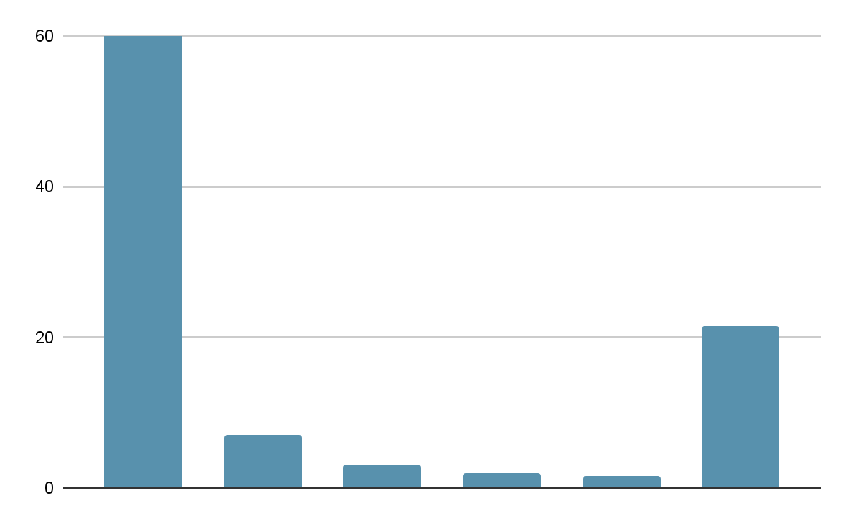
Creating a List - 200
Selecting the 200 most frequent words, we can make a list and check it’s coverage.
Total coverage is 78.6%.
It still seems a little low.
Let’s try 300 of the most frequent words…
AWL
A200
NIL
65%
7.1%
3.1%
1.9%
1.5%
21.4%
1000
2000
3000

Slide 27
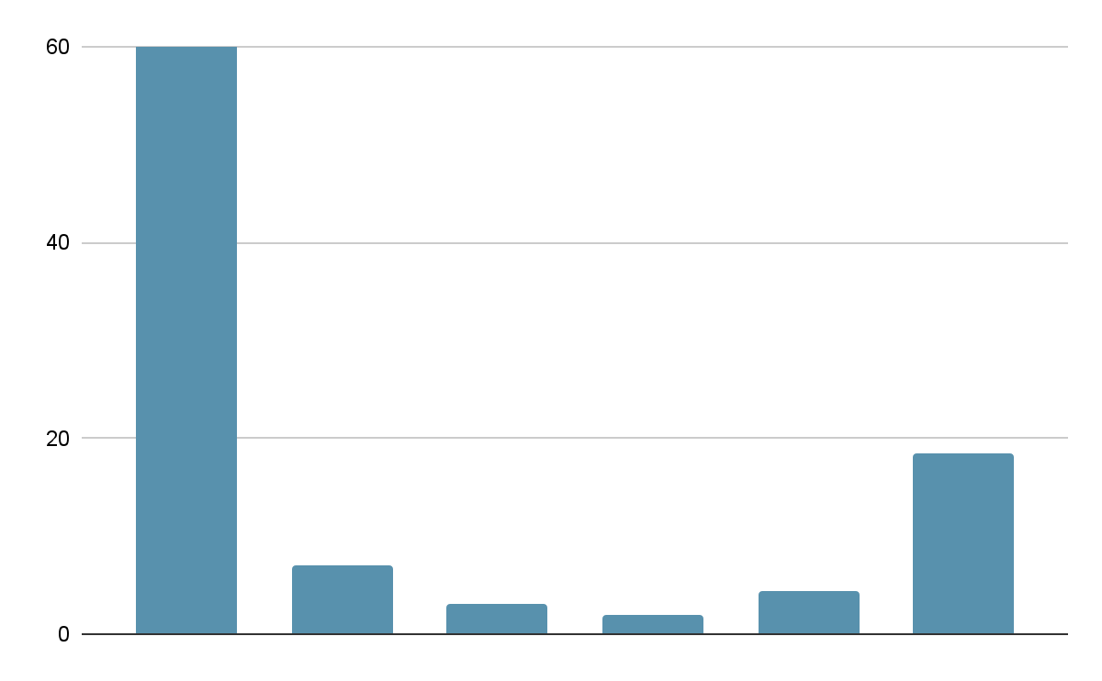
Creating a List - 300
Selecting the 300 most frequent words, we can make a list and check it’s coverage.
Total coverage is now 81.5%.
That’s better, but I think we could do better.
Let’s try 400 of the most frequent words…
AWL
A300
NIL
65%
7.1%
3.1%
1.9%
4.4%
18.5%
1000
2000
3000

Slide 28
Creating a List - 400
Selecting the 400 most frequent words, we can make a list and check it’s coverage.
Total coverage is now 82.2%.
Our returns on more vocabulary are decreasing.
Let’s try one more: 500 words.
AWL
A400
NIL
65%
7.1%
3.1%
1.9%
5.1%
17.8%
1000
2000
3000

Slide 29
Creating a List - 500
Selecting the 400 most frequent words, we can make a list and check it’s coverage.
Total coverage is now 82.6%.
Now the increase in coverage is becoming very small. That was just 0.4% increase.
AWL
A500
NIL
65%
7.1%
3.1%
1.9%
5.1%
17.8%
1000
2000
3000

Slide 30
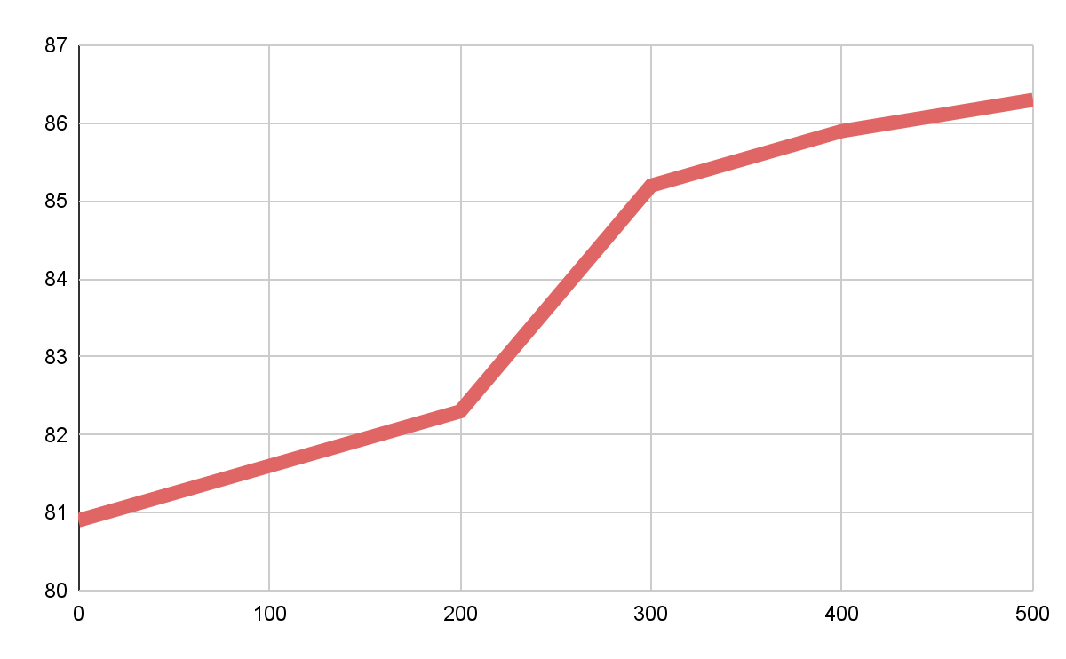
Fine-Tuning the List
Increasing the list of words in the new ‘Architecture Vocabulary list’ from 300 to 400 increases the number of words found from 27,834 to 32,202. A meaningful increase, but the coverage only increases from 82% to 84%.
Choosing the 500 top words increases the word count to 34,739, or 85.4%. The increase in vocabulary items is providing diminishing returns.

Slide 31
Creating a List
The coverage with no architecture vocabulary was 80.9.
That coverage increased to 86.3% with the addition of only 300 words.
Over 4 semesters of 14 lessons each, that is an extra burden of only 5 extra words per lesson.
Words in list
300
Coverage Change
Increased 5.4% - from 75% to 82%

Slide 32
Final Remarks
Development
This is not a one-off process.
We should continue to add to the corpus, test out methods of gaining maximum coverage for minimal vocabulary learning burden on students and class time.
As long as it benefits the students in their goals of functioning in an international realm.
Limitations
I created this corpus using only textbooks.
This is only one register that students will need to learn, but it is one that is easy to access.

Slide 33
Final Remarks
Necessary
Simple
Free
It is necessary to provide the students with the tools they need to work in their specific industry.
Our list can be created simply using only a few steps
We can use freely available software.

Slide 34
Thanks!
Do you have any questions?
andrew blaker
a.blaker@kwansei.ac.jp
Please keep this slide for attrbution

Slide 35
References
NGSL
http://www.newgeneralservicelist.org/
AWL
https://www.eapfoundation.com/vocab/academic/awllists/
Averil Coxhead’s Publications
https://people.wgtn.ac.nz/averil.coxhead/publications
AntWordProfiler
https://people.wgtn.ac.nz/averil.coxhead/publications
Online Vocabulary Processing
https://www.lextutor.ca/
My Paper on the topic
https://docs.google.com/document/d/17WgznsxCxvKmzVc5L7FTZVDkQZHXApXF

